Slide 1
THE TUTORIAL BUILDER SYSTEM

Slide 2
Introduction
The Tutorial Builder System
George Cherian
Neil Chettiar
Omkar Narkar

Slide 3
Problem Statement
Data in today's world is spread out over thousands of different places
No limit to the number of places holding information

Slide 4
Problem Statement
No guarantee to the grade or relevance of the information
Combine all data to a single location after judging relevant information.

Slide 5
Aims And Objectives
Create a system to prepare tutorials based on input subject and stream
Create a user centric easy to use system
Help the user get information from multiple locations in a single location

Slide 6
Aims And Objectives
Crawl the web and gather information efficiently
Prepare the information in the best possible way.

Slide 7
Scope
Can be extended across multiple branches
Can be used as a massive time saver by any one looking for data on any project.

Slide 8
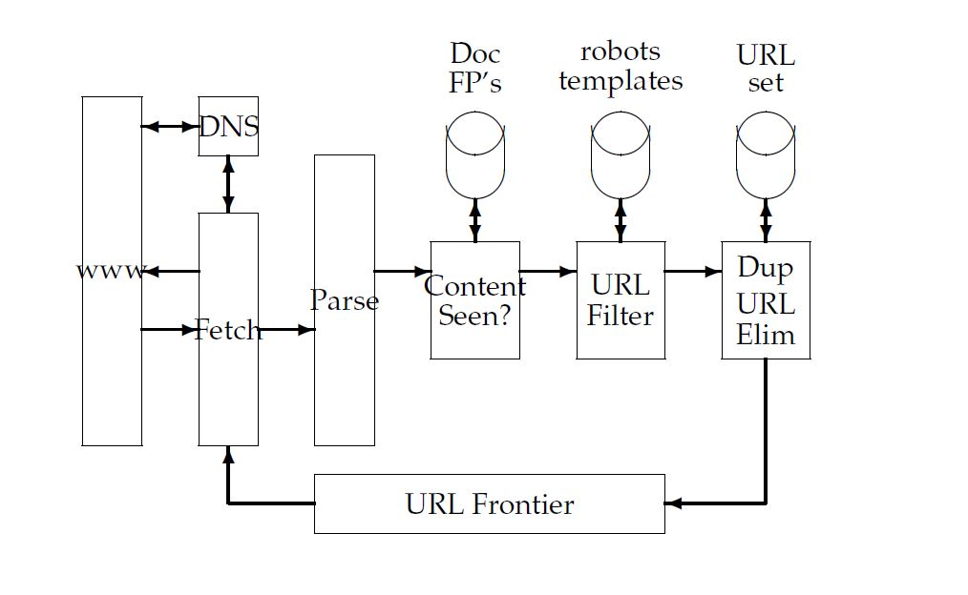
Literature Survey
Web Crawler: Architecture

Slide 9
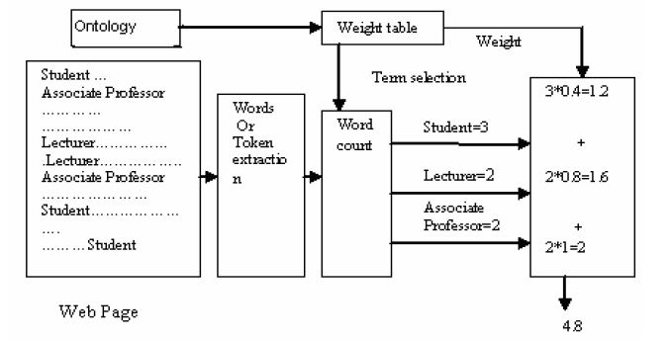
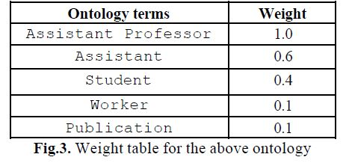
Literature Survey
Web Crawler: Added Functionality

Slide 10
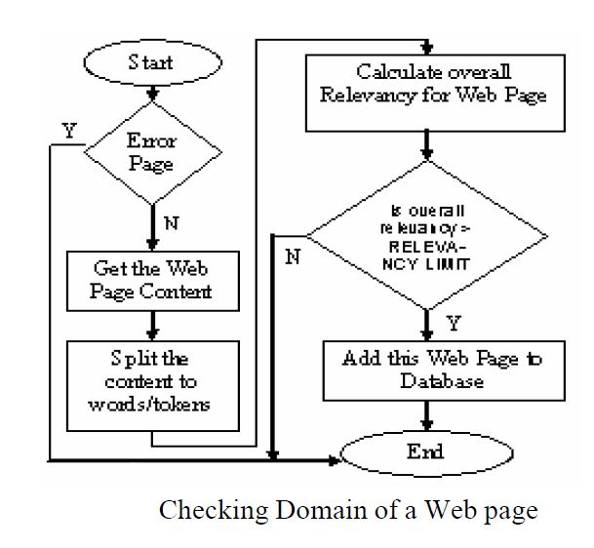
Literature Survey
Web Crawler: Added Functionality

Slide 11
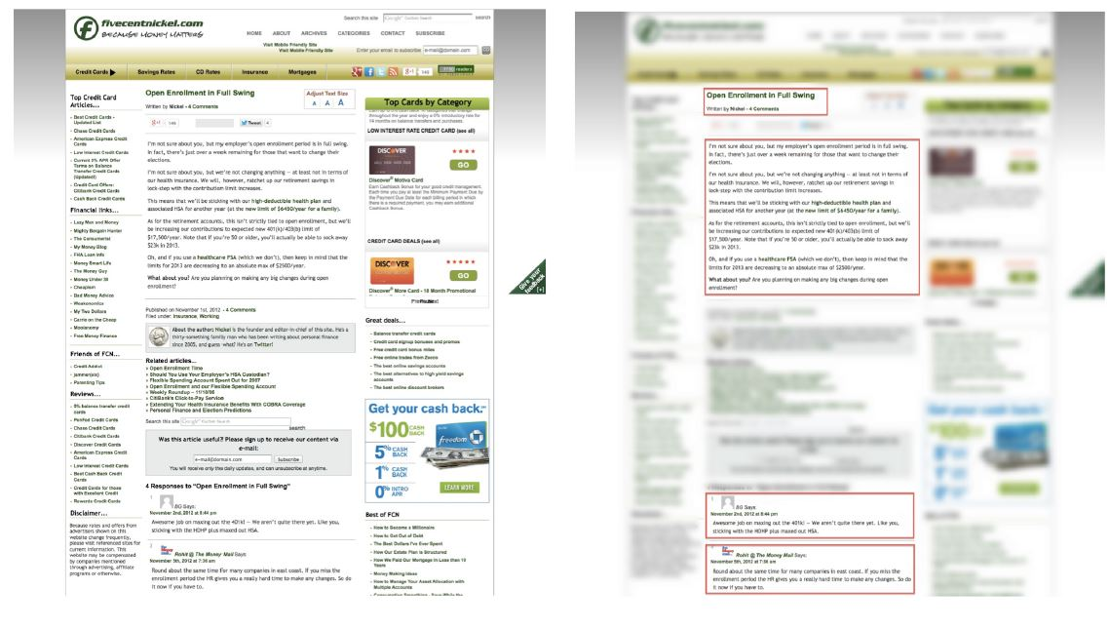
Literature Survey
Machine Learning: Text Extraction

Slide 12
Literature Survey
Data Ranking:
Use a Probabilistic Model for ranking of data
It caters to the terms held by a document and whether that same set of terms is held by other documents
The more documents mentioning the term the higher the rank of the document
Terms can be assigned weights so that more important terms can realize higher weights for documents carrying them

Slide 13
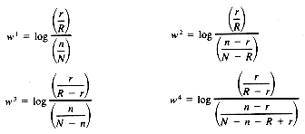

Formula Used
N = the number of documents in the collection
R = the number of relevant documents for query q
n = the number of documents having term t
r = the number of relevant documents having term t
Q = the number of matching terms between document j and query k
C = a constant for tuning the similarity function
n_{i} = the number of documents having term i in the data set
N = the number of documents in the data set

Slide 14
Proposed System
User input centric tutorial builder
Takes input from user in the form of subject and stream
Crawls web for relevant data
Formulates and returns Tutorial to the user

Slide 15
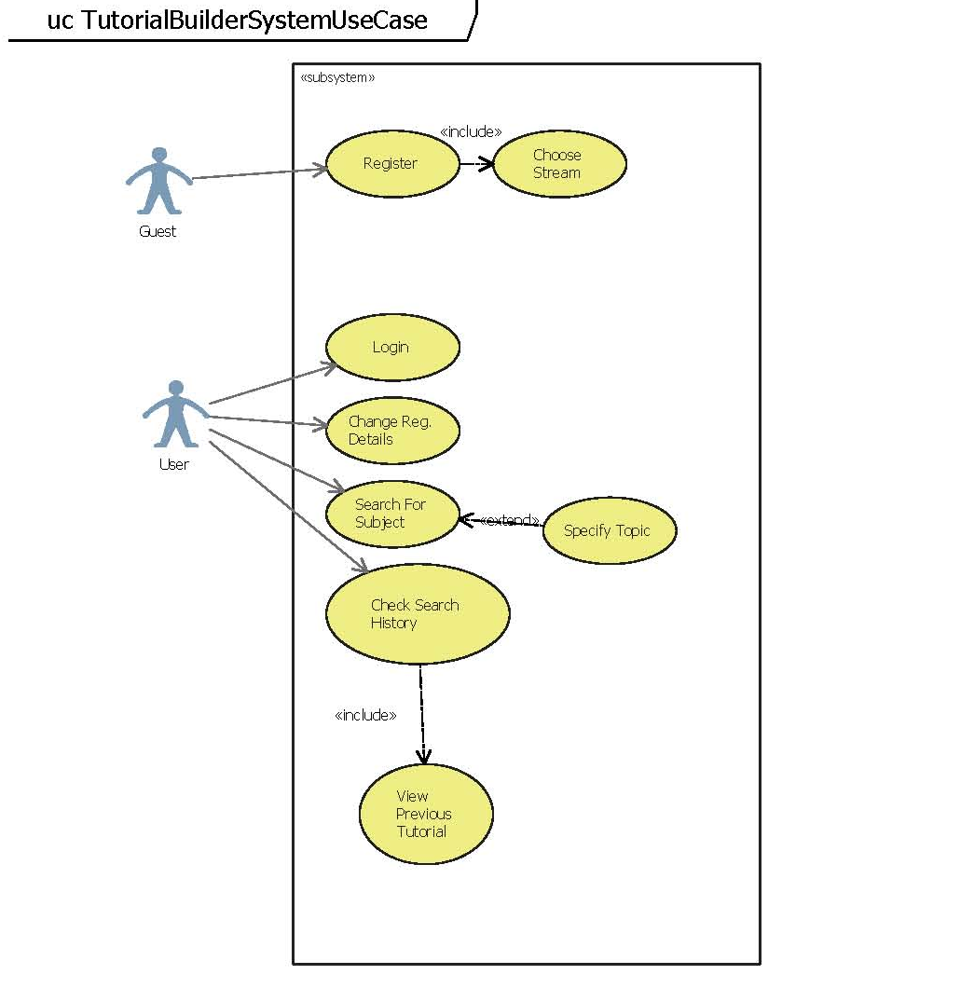
Proposed System(UML Diagrams)

Slide 16
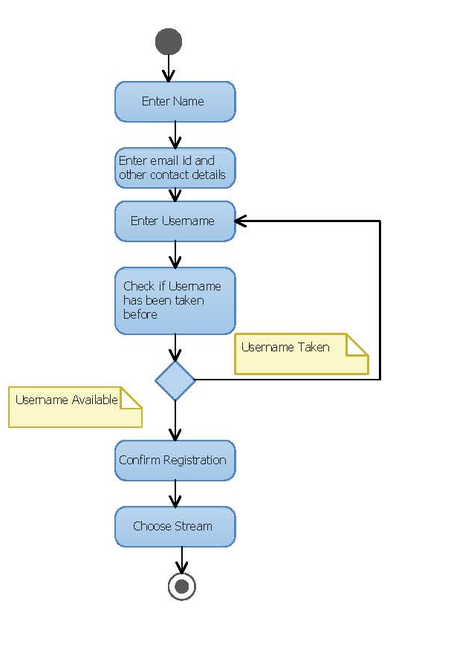
Proposed System(UML Diagrams)

Slide 17
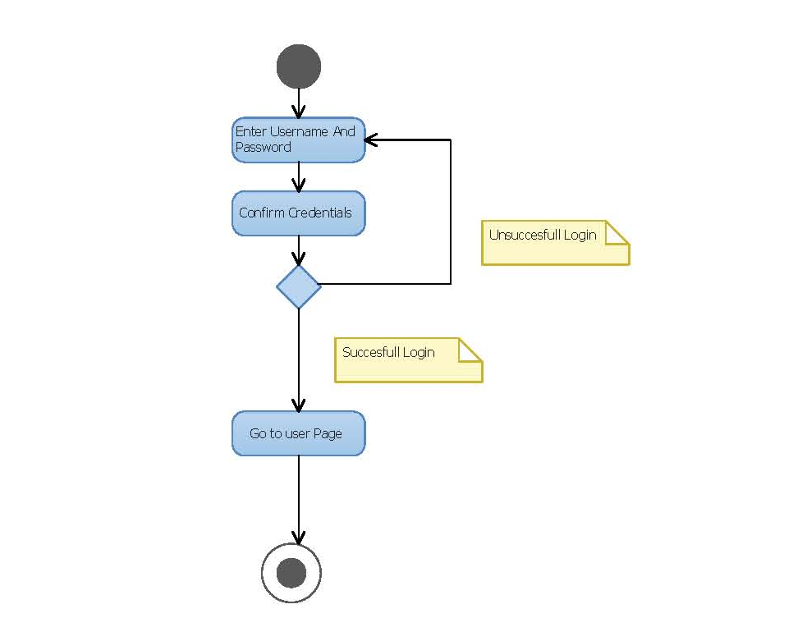
Proposed System(UML Diagrams)

Slide 18
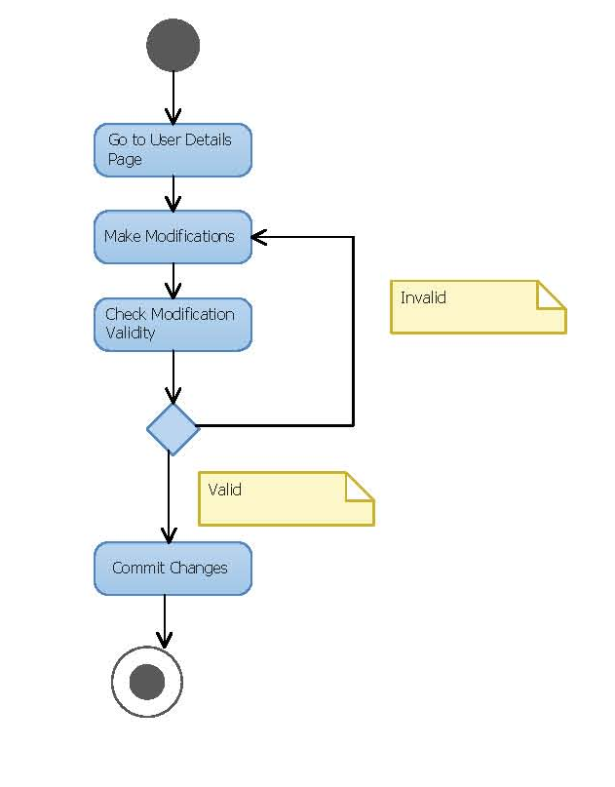
Proposed System(UML Diagrams)

Slide 19
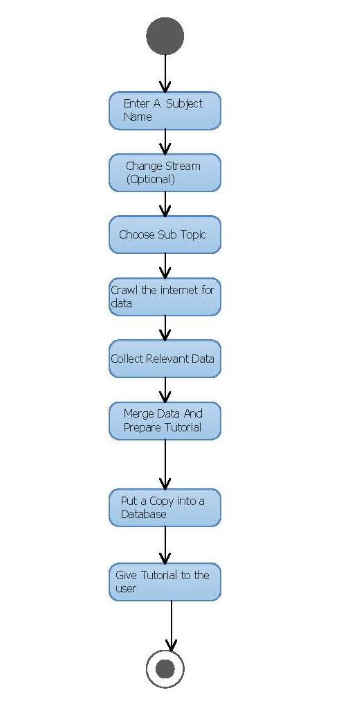
Proposed System(UML Diagrams)

Slide 20
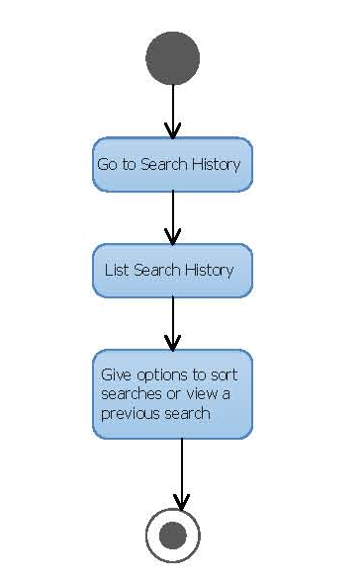
Proposed System(UML Diagrams)

Slide 21
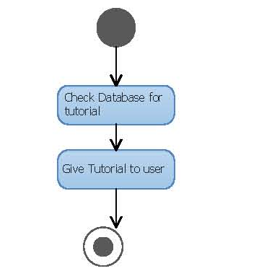
Proposed System(UML Diagrams)

Slide 22
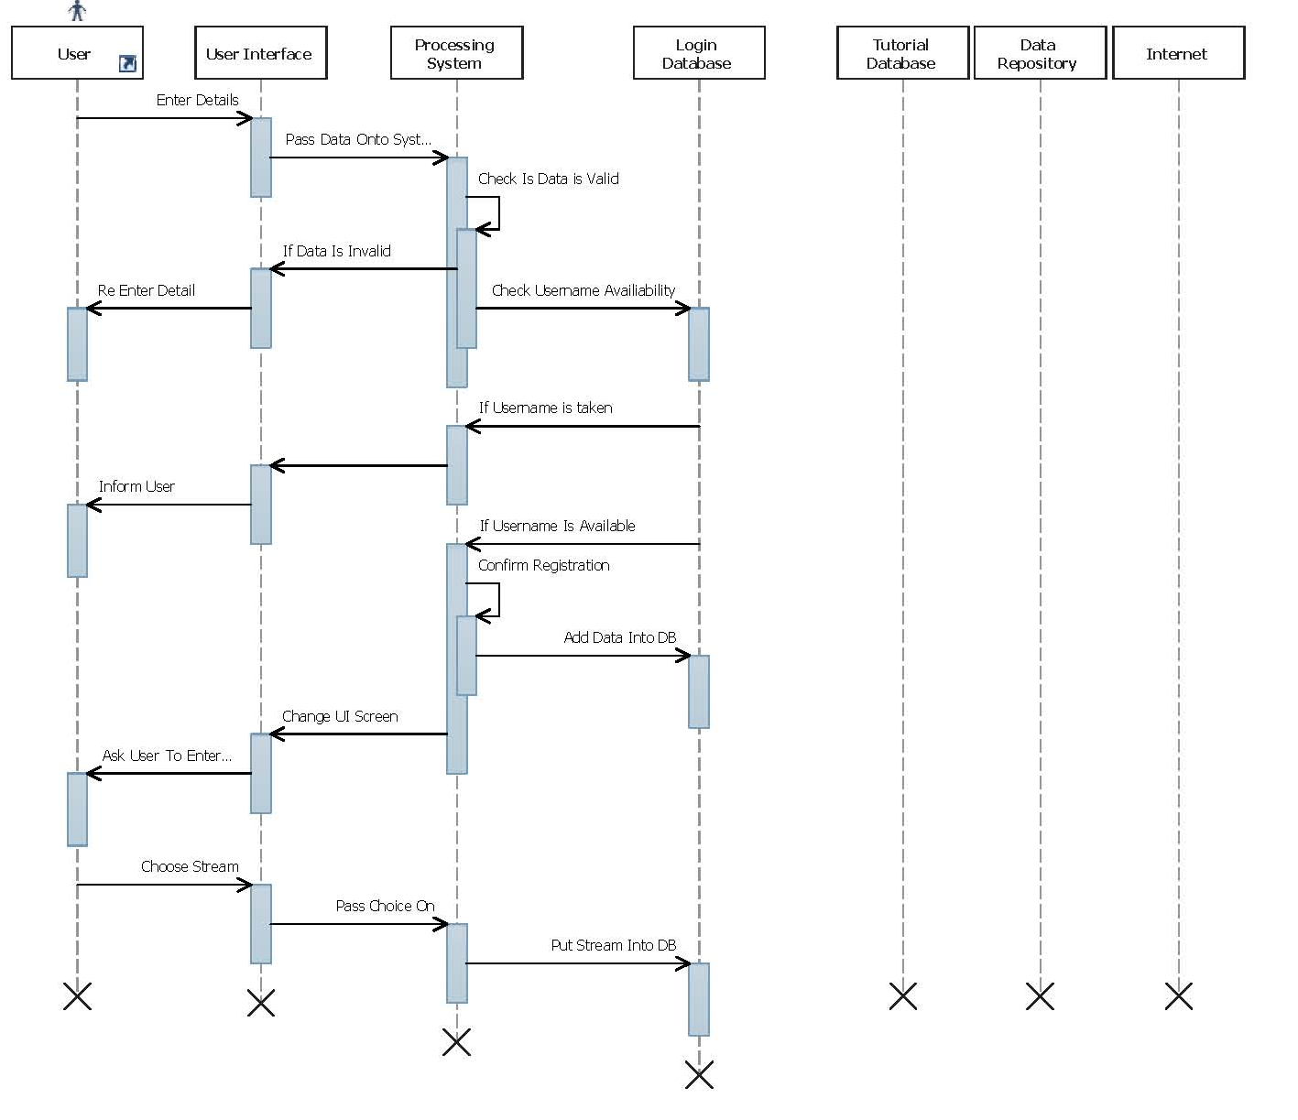
Proposed System(UML Diagrams)

Slide 23
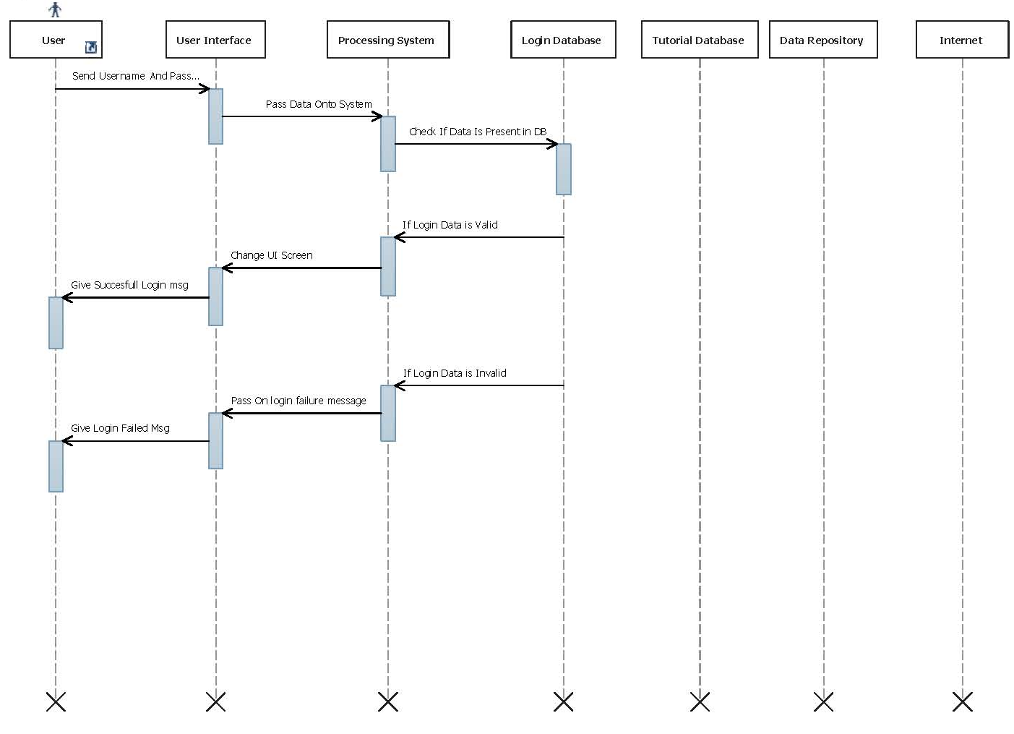
Proposed System(UML Diagrams)

Slide 24
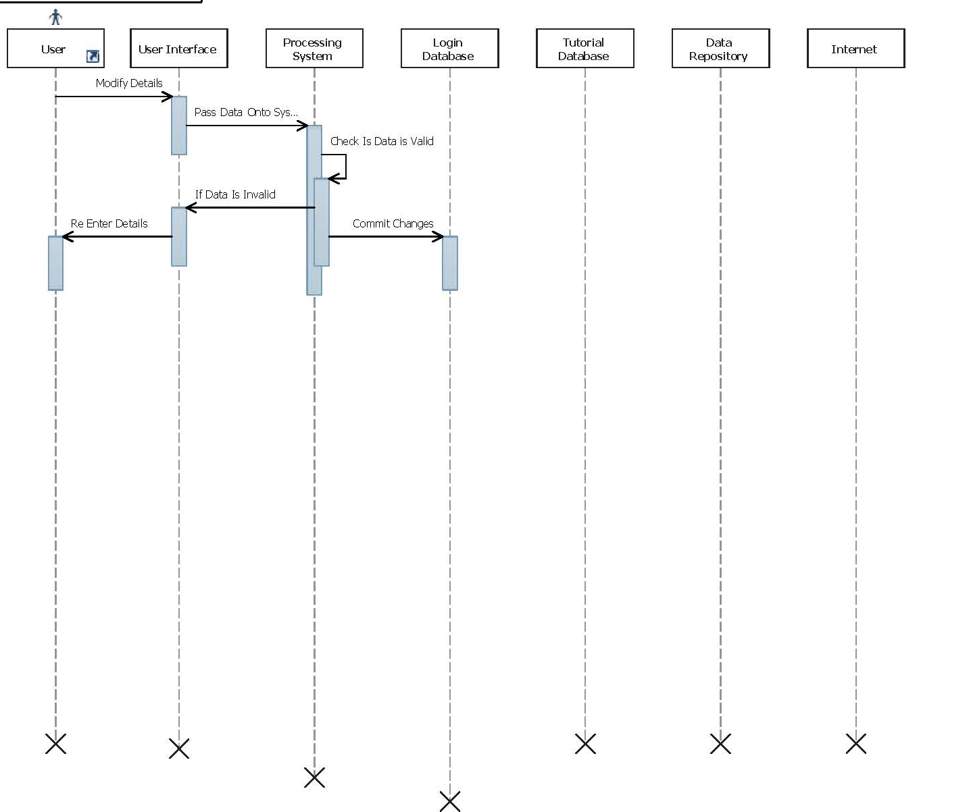
Proposed System(UML Diagrams)

Slide 25
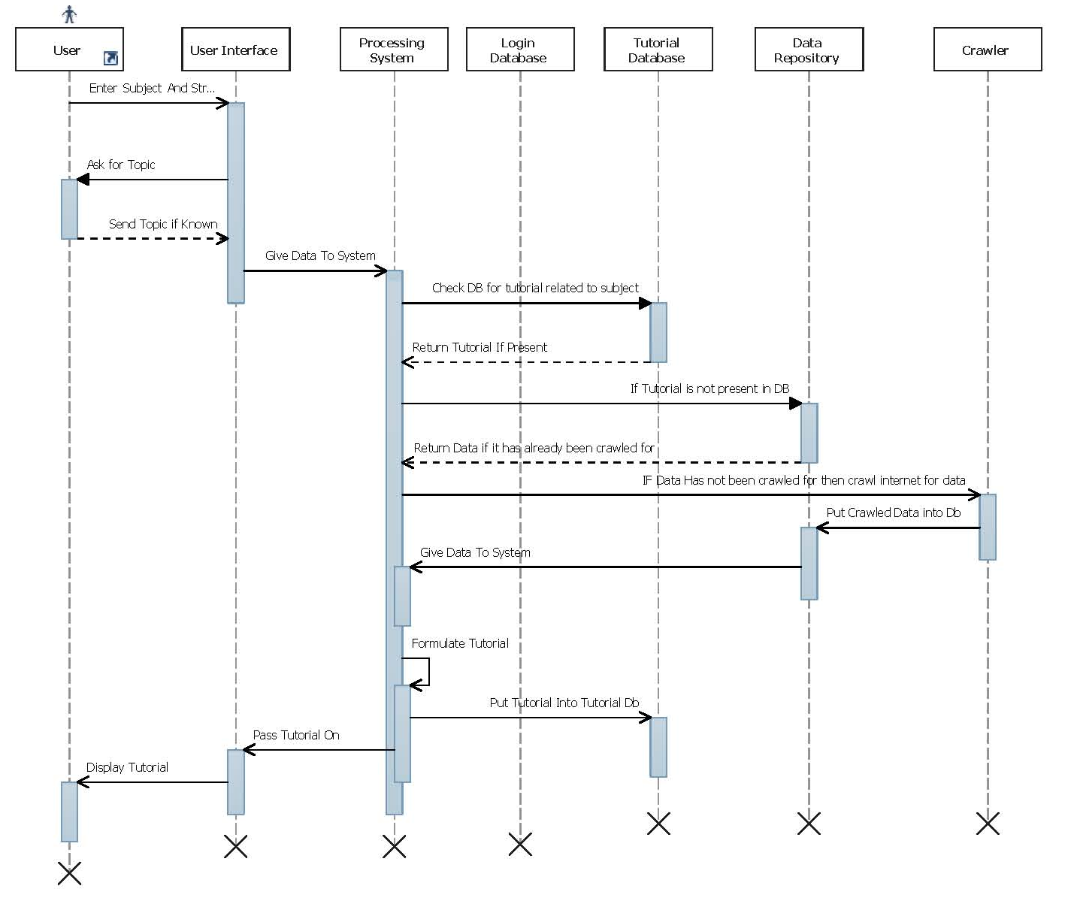
Proposed System(UML Diagrams)

Slide 26
Proposed System(UML Diagrams)

Slide 27
Methodology
Take Data from user
Check Database for previously existing Tutorial.
If none then sent crawlers for data.
Store data in a database

Slide 28
Methodology
Gather a list of topics
Prepare the tutorial
Present the list of topics or topic asked for

